Slide 1
Installation & Simulation using ns-3
Mr. Shivaji R. Lahane
shivajilahane@gmail.com

Slide 2
Agenda
Getting started with installation on ubuntu 14.04 and above
Say “Hello to the Simulator”
Structure of a C++ program in ns-3
Sample Program with two nodes in point-to-point network: UDP Traffic
Sample Program for LAN: UDP Traffic
Ref.: http://www.nsnam.org/

Slide 3
Getting started with installation . . . [ns-3] Installing and Testing ns-3 with NetAnim on Ubuntu 14.04 and above
ns-3 version considered: ns-allinone-3.20 and above… List of Prerequisite Packages to be installed: 1. gcc 2. g++ 3. python 4. python-dev (Optional: If you want to use Python as the main language for network configuration) 5. mercurial (Optional: If you choose Method 2 (explained below) for downloading and installing ns-3) 6. qt4-dev-tools (Optional: If you want to install *NetAnim* (animator for ns- 3) along with ns-3) 7. tcpdump (Optional: Required for analyzing packet capture files (.pcap) generated by ns-3) 8. wireshark (Optional: Alternative to tcpdump. You can use anyone of these) 9. gnuplot (Optional: Required for plotting high quality graphs through *.dat* files generated by ns-3)
Ref.: http://www.nsnam.org/

Slide 4
Installing Prerequisite Packages: Give the following command to install the above mentioned packages: sudo apt-get install gcc g++ python python-dev mercurial qt4-dev-tools tcpdumpwiresharkgnuplot You may remove the optional package's name from the above command if it is not required!
Downloading ns-3: ns-3 can be downloaded in at least two different ways [1]:
Ref.: http://www.nsnam.org/

Slide 5
Method 1 (Recommended for beginners): Downloading a ns-3 tarball i.e., a zipped folder (We follow this method here) Go to following link to download ns-allinone-3.20 tarball: https://www.nsnam.org/release/ns-allinone-3.20.tar.bz2 For older versions of ns-3, you can download the tarball from the following link: http://www.nsnam.org/releases/older/
Ref.: http://www.nsnam.org/

Slide 6
Method 2: Downloading through *bake* You need to have packages 4 and 5 from the list shown above to download ns-3 using bake. Once the prerequisite packages are installed, follow the instructions given on Method [1] to download ns-3:
Ref.: http://www.nsnam.org/

Slide 7
Installing ns-3 and NetAnim: ns-3 can be installed in three different ways [2]: Method 1: by using build.py (We follow this method now) Method 2: by using bake Method 3: by using Waf For Method 2 and Method 3 of installation, follow Method [2].
After you have followed Method 1 for downloading ns-allinone-3.20 tarball, you may keep your downloaded tarball on the Desktop and then follow the steps given below to install it:
NOTE: NetAnim (the animator for ns-3) package comes bundled in ns-allinone-3.xx tarball. So if you want to install *NetAnim* along with ns-allinone-3.20, then install qt4-dev-tools package before you proceed to the next steps because when you try to install ns-allinone-3.xx package, it first tries to install NetAnim. It searches for qt4-dev-tools package and if it is not found - NetAnim installation will be skipped! Alternatively, you can also choose to install NetAnim later via apt-get
Ref.: http://www.nsnam.org/

Slide 8
Step 1: Go to Desktop via terminal and unzip the ns-allinone-3.20.tar.bz2 tarball cd Desktop tar xjf ns-allinone-3.20.tar.bz2 Step 2: Go in ns-allinone-3.20 folder and give the following command for installation: ./build.py --enable-examples --enable-tests After a while, you may see the following message Leaving directory './ns-3.20' which indicates that ns-3 is installed !!!
Ref.: http://www.nsnam.org/

Slide 9
Testing ns-3: To test whether all modules of ns-3 are installed successfully, follow the procedure as given below: Step 1: Go to ns-allinone-3.20/ns-3.20 folder and give the following directory: ./test.py -c core Some tests may be skipped while testing but that should not bother you if your module is not among those that were skipped!
Ref.: http://www.nsnam.org/

Slide 10
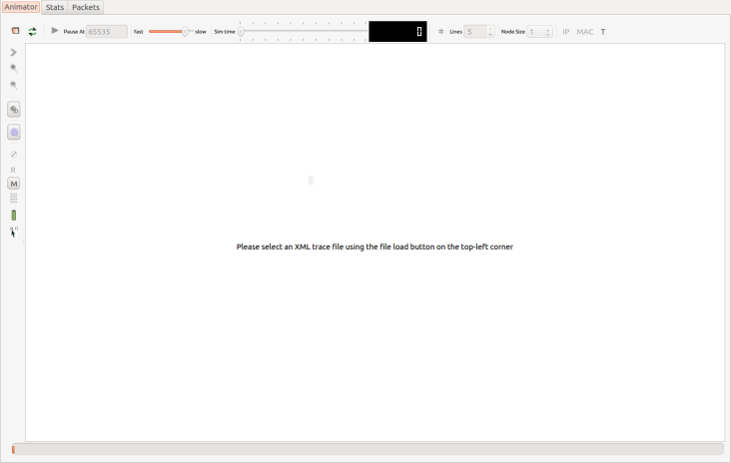
Testing NetAnim (only for those users who installed qt4-dev-tools package before ns-3 installation): To test whether NetAnim is installed successfully, follow the procedure given below: Step 1: Go to ns-allinone-3.20/netanim-3.105 and give the following command: ./NetAnim A window as shown below should open:
Ref.: http://www.nsnam.org/

Slide 11
Structure of a C++ Program in ns-3
Include necessary header files
Use appropriate namespace
Enable logging for different modules
Create nodes
Create network devices with MAC and PHY
Attach network devices to nodes and set the interconnections
Install protocol stack in nodes
Set network addresses for interfaces
Install applications in nodes
Set application start and stop time
Run the simulation
Release resources at the end of the simulation
11
Ref.: http://www.nsnam.org/

Slide 12
……….Structure of a C++ Program in ns-3
Include necessary header files
Use appropriate namespace
12
Ref.: http://www.nsnam.org/

Slide 13
first.cc
#include "ns3/core-module.h"
#include "ns3/network-module.h"
#include "ns3/internet-module.h"
#include "ns3/point-to-point-module.h"
#include "ns3/applications-module.h"
using namespace ns3;
NS_LOG_COMPONENT_DEFINE ("FirstScriptExample");
13
Ref.: http://www.nsnam.org/

Slide 14
……….Structure of a C++ Program in ns-3
Enable logging for different modules
Create nodes
14
Ref.: http://www.nsnam.org/

Slide 15
. . . first.cc
int main(int argc, char *argv[]) {
LogComponentEnable("UdpEchoClientApplication", LOG_LEVEL_INFO);
LogComponentEnable("UdpEchoServerApplication", LOG_LEVEL_INFO);
NodeContainer nodes;
nodes.Create(2);
15
Ref.: http://www.nsnam.org/

Slide 16
……….Structure of a C++ Program in ns-3
Create network devices with MAC and PHY
Attach network devices to nodes and set the interconnections
Install protocol stack in nodes
16
Ref.: http://www.nsnam.org/

Slide 17
. . . first.cc
PointToPointHelper pointToPoint;
pointToPoint.SetDeviceAttribute ("DataRate", StringValue ("5Mbps"));
pointToPoint.SetChannelAttribute ("Delay", StringValue ("2ms"));
NetDeviceContainer devices;
devices = pointToPoint.Install (nodes);
InternetStackHelper internet;
internet.Install (nodes);
17
Ref.: http://www.nsnam.org/

Slide 18
……….Structure of a C++ Program in ns-3
Set network addresses for interfaces
Install applications in nodes
Set application start and stop time
18
Ref.: http://www.nsnam.org/

Slide 19
. . . first.cc
Ipv4AddressHelper address;
address.SetBase ("10.1.1.0", "255.255.255.0");
Ipv4InterfaceContainer interfaces = address.Assign (devices);
UdpEchoServerHelper echoServer (9);
ApplicationContainer serverApps = echoServer.Install (nodes.Get (1));
serverApps.Start (Seconds (1.0));
serverApps.Stop (Seconds (10.0));
19
Ref.: http://www.nsnam.org/

Slide 20
. . . first.cc
UdpEchoClientHelper echoClient (interfaces.GetAddress (1), 9);
echoClient.SetAttribute ("MaxPackets", UintegerValue (1));
echoClient.SetAttribute ("Interval", TimeValue (Seconds (1.0)));
echoClient.SetAttribute ("PacketSize", UintegerValue (1024));
ApplicationContainer clientApps = echoClient.Install (nodes.Get (0));
clientApps.Start (Seconds (2.0));
clientApps.Stop (Seconds (10.0));
20
Ref.: http://www.nsnam.org/

Slide 21
……….Structure of a C++ Program in ns-3
Run the simulation
Release resources at the end of the simulation
21
Ref.: http://www.nsnam.org/

Slide 22
. . . first.cc
Simulator::Run ();
Simulator::Destroy ();
return 0;
}
How to run this C++ Program?
Go in ns-allinone-3.xx/ns-3.xx directory and give
./waf –-run scratch/first
22
Ref.: http://www.nsnam.org/

Slide 23

THANK YOU

